Slide 1
Program for Woodward-Fieser and Fieser-Kuhn Analysis of Polyenes
Hadleigh Schwartz

Slide 2
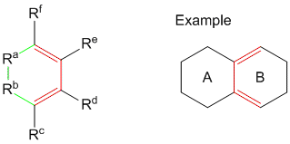
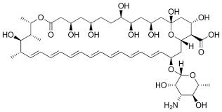
What Are Woodward-Fieser And Fieser-Kuhn Rules?
Predict wavelength of maximum absorbance of a polyene or diene
Woodward-Fieser – For dienes, including annular dienes, with at most four double bonds
Fieser-Kuhn –For polyenes with more than four double bonds
Quantified effects of substituents and conjugation on max absorption

Slide 3
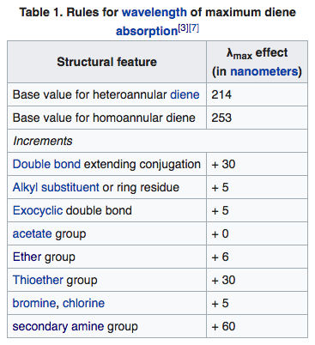
Woodward-Fieser Rules
Fieser-Kuhn Rules
λ_{max} = 114 + 5M + n(48 – 1.7n) – 16.5 R_{endo} – 10 R_{exo}
M is number of alkyl substituents or ring residues
n is number of conjugated double bonds
R_{endo} is number of rings with endocyclic bonds
R_{exo} is the number of rings with exocyclic double bonds

Slide 4
Why?
Highly conjugated molecules can be colored
Overlap of 3 or more p orbitals creates gap for electrons to jump upon absorbing a photon of energy
ΔE correspond to an energy, which if in the range of 390 and 700 nm, is in the visible spectrum
We can predict the color of the molecule upon its excitation

Slide 5
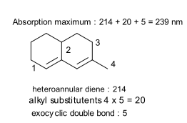

Slide 6
The Program
Automate analysis of diene/polyene molecule structure
Output wavelength of predicted max absorbance and display color
Use SMILES notation to input molecule structure
Use different algorithm for chain vs. annular diene

Slide 7
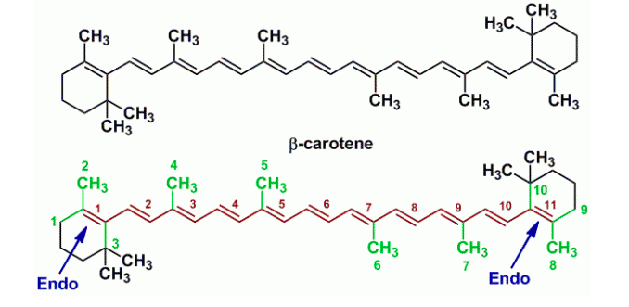
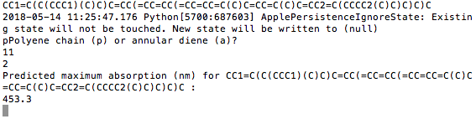


C(C1=C(C)CC(C(C)CC1)=CC=C(C)C=CC(C)=CC=CC=C(C)C=CC=C(C)C=CC=C(C)C=C(C2=C(C)(C)CCCC2(C))

Slide 8
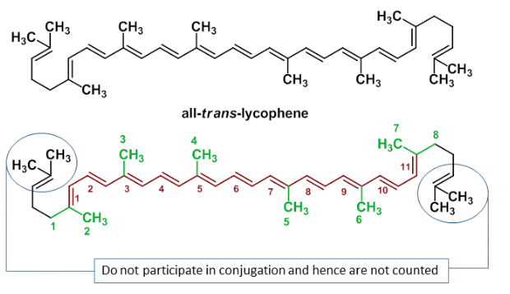
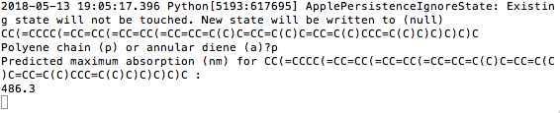



Slide 9
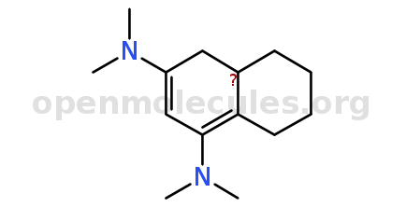
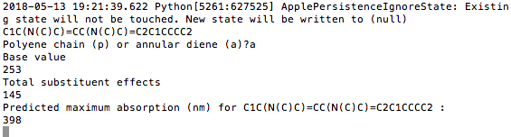


C1C(N(C)C)=CC(N(C)C)=C2C1CCCC2

Slide 10
